Slide 1
Abstract Factory Pattern

Slide 2
Introduction
It comes under “Creational Design Patterns”
Abstract Factory Pattern defines an interface or abstract class for creating families of related (or dependent) objects but without specifying their concrete sub-classes
That means Abstract Factory lets a class return a factory of classes. So, this is the reason that Abstract Factory Pattern is one level higher than the Factory Pattern

Slide 3
Advantages
Abstract Factory Pattern isolates the client code from concrete (implementation) classes
It eases the exchanging of object families
It promotes consistency among objects

Slide 4
Usage
When the system needs to be independent of how its objects are created, composed, and represented
When the family of related objects has to be used together, then this constraint needs to be enforced
When you want to provide a library of objects that does not show implementations and only reveals interfaces

Slide 5
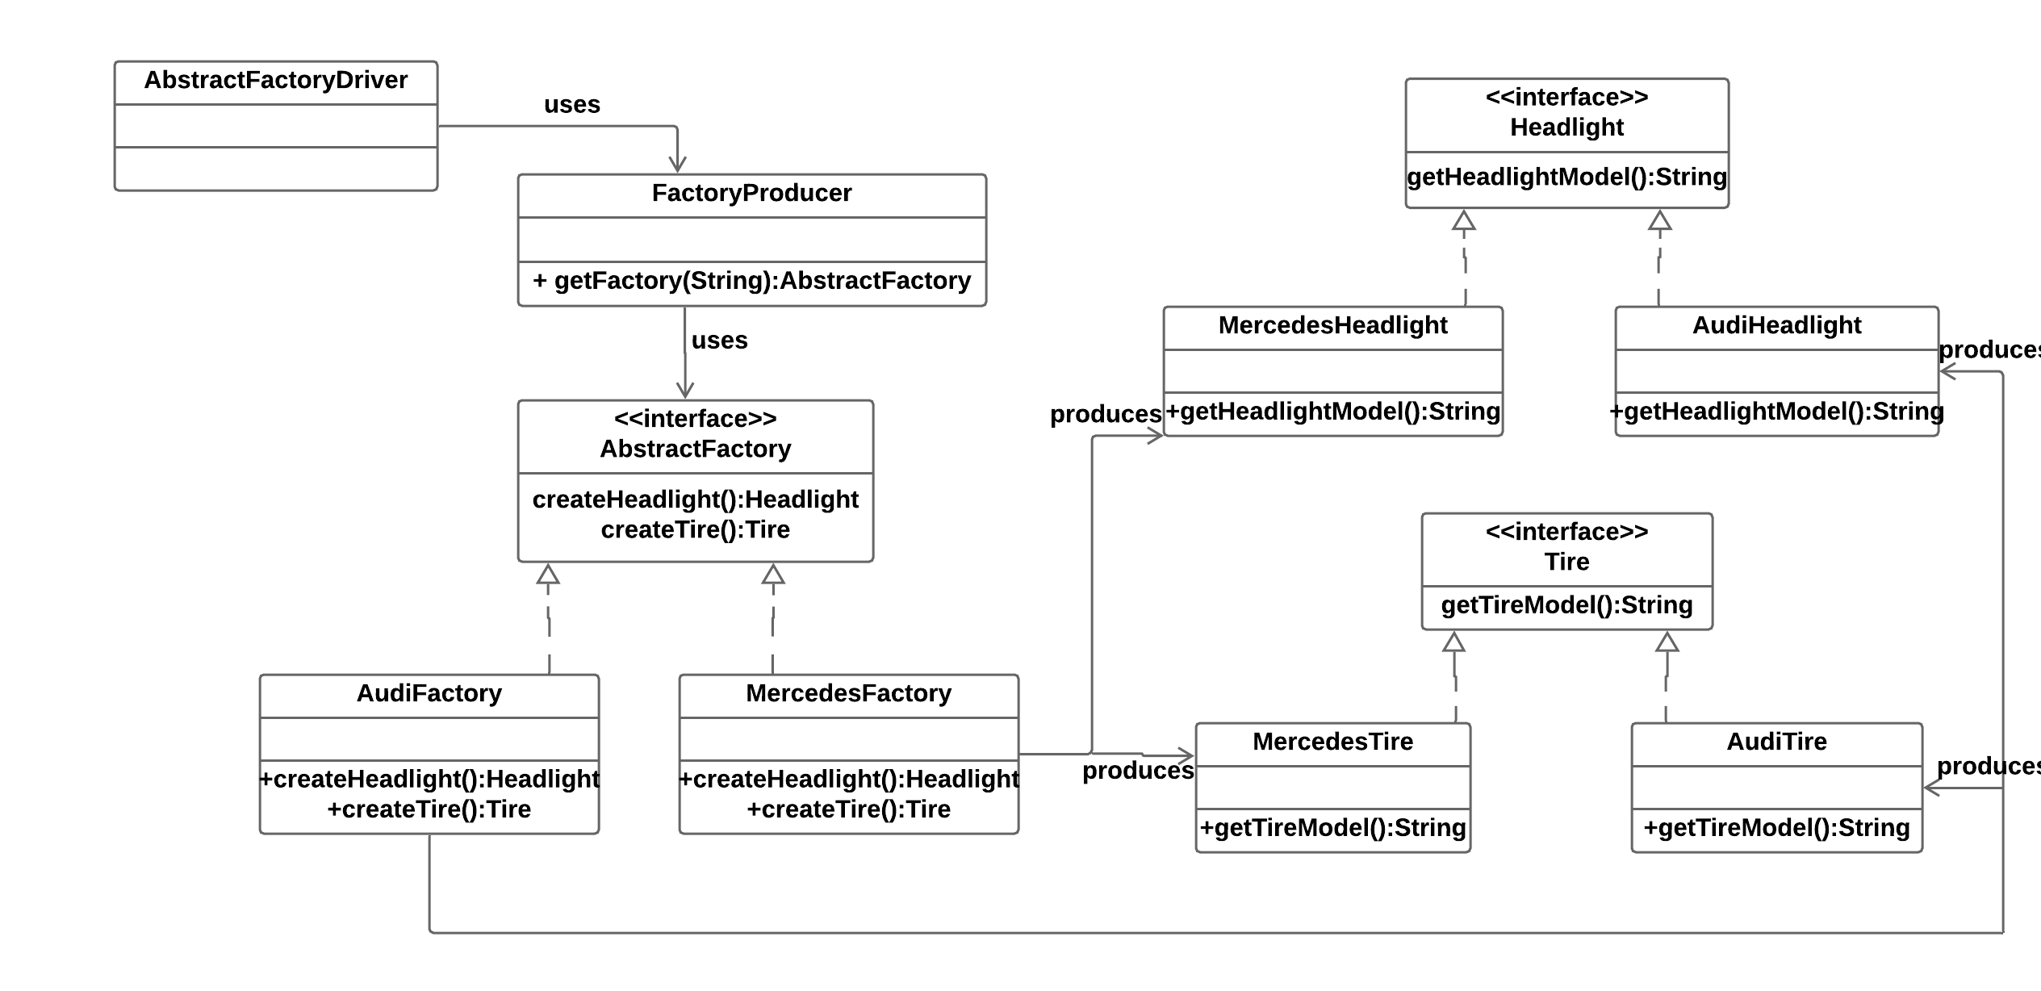
UML for Abstract Factory Pattern

Slide 6
Factory Method vs Abstract Factory
Factory method: You have a factory that creates objects that derive from a particular base class
Abstract factory: You have a factory that creates other factories, and these factories in turn create objects derived from base classes. You do this because you often don't just want to create a single object (as with Factory method) - rather, you want to create a collection of related objects

Slide 7
Factory Method Example
Imagine you are constructing a house and you approach a carpenter for a door. You give the measurement for the door and your requirements, and he will construct a door for you. In this case, the carpenter is a factory of doors. Your specifications are inputs for the factory, and the door is the output or product from the Factory

Slide 8
Abstract Factory Example
Now, consider the same example of the door. You can go to a carpenter, or you can go to a plastic door shop or a PVC shop. All of them are door factories. Based on the situation, you decide what kind of factory you need to approach. This is like an Abstract Factory

Slide 9
References
https://www.javatpoint.com/abstract-factory-pattern

Slide 10
Abstract Factory Pattern
The End

